Slide 1

A DEVICE PERFORMING OBJECT DETECTION TO HELP THE BLIND PEOPLE
Under the Guidance of
Ms.A.VANDANA PETER, ASSISTANT PROFESSOR
Department of Computer Science & Engineering
Godavari Institute of Engineering and Technology, Rajahmundry.
Presented by
B.PAVAN KUMAR 16551A0517
K.MUKTA 16551A0538
V.ESWARKUMAR 16551A05B1
RUPESH SHAH 16551A05B5

Slide 2
Abstract
Abstract
Introduction
Existing System
Proposed System
Software requirements
Architecture Model
Modules
UML Diagrams/ER Diagrams/Flow Charts
References
In today’s technology driven world, technology takes its own place in fulfilling the needs of every individual. It also plays a very key role in the life Physically Disabled people. But coming to the point of Blind people, no matter what advanced technology you give them, they may not operate because they don’t have the ability to see and use the devices. Not only devices, they need to depend on others completely for every small task. In order to fulfill the above missing parts of the blind people, we proposed a device embedded with advanced technology which will make the person to do their own work rather than being dependent on others.

Slide 3
Abstract
Introduction
Existing System
Proposed System
Software requirements
Architecture Model
Modules
UML Diagrams/ER Diagrams/Flow Charts
References
Abstract
Introduction
Existing System
Literature Review
Methodology
Schedule of Completion and Plan of Action
Proposed System
Software requirements
Architecture Model
Modules
UML Diagrams/ER Diagrams/Flow Charts
References
Abstract
Introduction
Existing System
Proposed System
Software requirements
Architecture Model
Modules
UML Diagrams/ER Diagrams/Flow Charts
References
Introduction
To create a new approach for the visually challenged
people, which helps them to perform their tasks
independently.
Machine Learning &deep learning convolution Neural Networks are in existence.
Object detection procedure takes place and user can identify the object by listening to the voice from the device.

Slide 4
Abstract
Introduction
Existing System
Literature Review
Methodology
Schedule of Completion and Plan of Action
Proposed System
Software requirements
Architecture Model
Modules
UML Diagrams/ER Diagrams/Flow Charts
References
Abstract
Introduction
Existing System
Proposed System
Software requirements
Architecture Model
Modules
UML Diagrams/ER Diagrams/Flow Charts
References
Abstract
Introduction
Existing System
Proposed System
Software requirements
Architecture Model
Modules
UML Diagrams/ER Diagrams/Flow Charts
References
Introduction
The project comes under the domain Machine Learning which is the part of Artificial Neural Network. Machine Learning concepts makes the system learn on its own from the experiences it gains, without the interference of the external factors. The Regional(R-CNN)algorithm using Convolutional Neural Network is used for the detection purpose.

Slide 5
Introduction
Existing System
Proposed System
Software requirements
References
Abstract
Introduction
Existing System
Literature Review
Methodology
Schedule of Completion and Plan of Action
Proposed System
Software requirements
Architecture Model
Modules
UML Diagrams/ER Diagrams/Flow Charts
References
Existing System
Traditional object detection is built on handcrafted features and shallow trainable architectures. Their performance easily stagnates by constructing complex ensembles which combine multiple low-level image features with high-level context from object detectors and scene classifiers.

Slide 6
Introduction
Existing System
Proposed System
Software requirements
References
Abstract
Introduction
Existing System
Literature Review
Methodology
Schedule of Completion and Plan of Action
Proposed System
Software requirements
Architecture Model
Modules
UML Diagrams/ER Diagrams/Flow Charts
References
Existing System
Numerous researchers and experts have done many prominent and effective researches and given various effective approaches.
We all know that the key point related to co-segmentation is to automatically extract common/multi-class information from multiple images by forcing the segments to be consistent.

Slide 7
Introduction
Existing System
Proposed System
Software requirements
References
Abstract
Introduction
Existing System
Literature Review
Methodology
Schedule of Completion and Plan of Action
Proposed System
Software requirements
Architecture Model
Modules
UML Diagrams/ER Diagrams/Flow Charts
References
Literature Review
Until now only some of the applications exist for blind people which serve different functionality to help them in a day to day life.
But it has many technological threats still exists in background subtraction.
Less work done on application for blind person but there are some existing applications like:
Blinddroid wallet
Color detector
Blind Bargain

Slide 8
Introduction
Existing System
Proposed System
Software requirements
References
Abstract
Introduction
Existing System
Literature Review
Methodology
Schedule of Completion and Plan of Action
Proposed System
Software requirements
Architecture Model
Modules
UML Diagrams/ER Diagrams/Flow Charts
References
Methodology
Object detection and tensor flow models are used to avoid the collision between objects and the blind person to make the blind person more independently and more conveniently.
To give notification about the presence of an obstacle, a voice alert is produced through headphones or speaker by voice playback module in order to avoid collision between the blind person and obstacles.

Slide 9
Introduction
Existing System
Proposed System
Software requirements
References
Abstract
Introduction
Existing System
Proposed System
Software requirements
Architecture Model
Modules
UML Diagrams/ER Diagrams/Flow Charts
References
Abstract
Introduction
Existing System
Literature Review
Methodology
Schedule of Completion and Plan of Action
Proposed System
Software requirements
Architecture Model
Modules
UML Diagrams/ER Diagrams/Flow Charts
References
Proposed System
Ranking of Segmentation Easiness An image is easy to segment if the foreground stands out from the homogeneous background. For such images, there should be a clean separation between foreground and background with clear boundaries, and the resultant segments should contain complete foreground objects.
This score is based on the region’s color contrast with respect to the whole image, with weighted sum contributions from the neighboring regions. Subsequently, more salient regions are segmented out using a graph cut. Upon segmentation, the saliency ranking Rsal is computed.
2/10

Slide 10
Introduction
Existing System
Proposed System
Software Requirements
References
Abstract
Introduction
Existing System
Proposed System
Software requirements
Architecture Model
Modules
UML Diagrams/ER Diagrams/Flow Charts
References
Abstract
Introduction
Existing System
Literature Review
Methodology
Schedule of Completion and Plan of Action
Proposed System
Software requirements
Architecture Model
Modules
UML Diagrams/ER Diagrams/Flow Charts
References
Software Requirements
Python 3.6
Open CV
Deep Learning
Tensor Flow 2.0
Google Text to Speech(API)
2/10

Slide 11
Abstract
Introduction
Existing System
Literature Review
Methodology
Schedule of Completion and Plan of Action
Proposed System
Software requirements
Architecture Model
Modules
UML Diagrams/ER Diagrams/Flow Charts
References
HardwareRequirements
Raspberry Pi 3
Mobile Camera
SD card
Headphones

Slide 12
Modules
Abstract
Introduction
Existing System
Proposed System
Software requirements
Architecture Model
Modules
UML Diagrams/ER Diagrams/Flow Charts
References
Object identification:
Camera ,SD card, headphones.
Voice feedback:
Alerting the visual challenged person through voice.

Slide 13
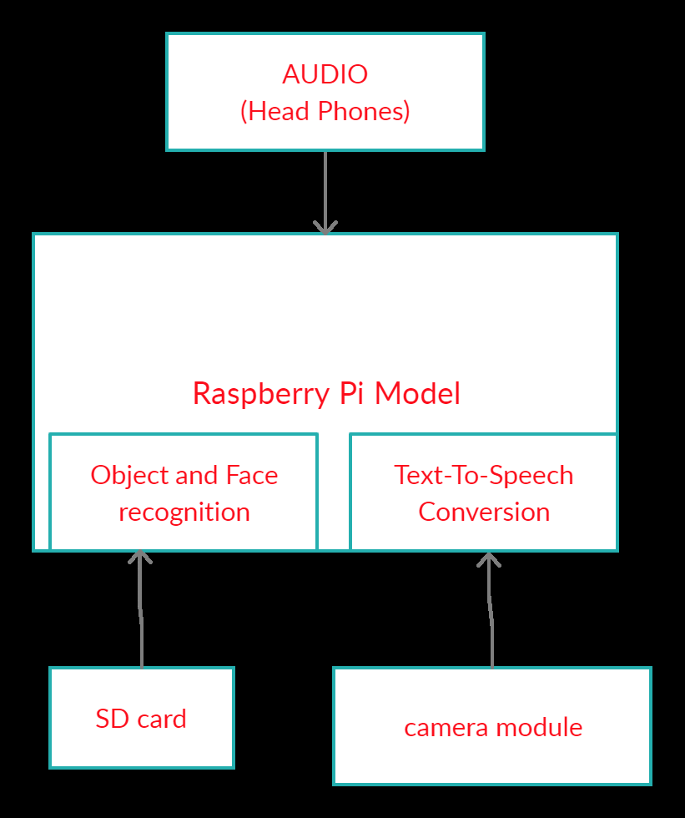
Architecture Model
Abstract
Introduction
Existing System
Proposed System
Software requirements
Architecture Model
Modules
UML Diagrams/ER Diagrams/Flow Charts
References
Abstract
Introduction
Existing System
Literature Review
Methodology
Schedule of Completion and Plan of Action
Proposed System
Software requirements
Architecture Model
Modules
UML Diagrams/ER Diagrams/Flow Charts
References
BLOCK DIAGRAM

Slide 14
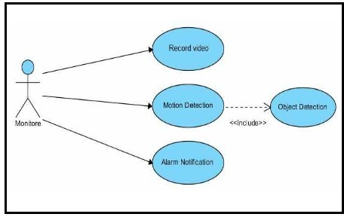
UML Diagrams/ER Diagrams/Flow Charts
Abstract
Introduction
Existing System
Proposed System
Software requirements
Architecture Model
Modules
UML Diagrams/ER Diagrams/Flow Charts
References
Use case diagram

Slide 15
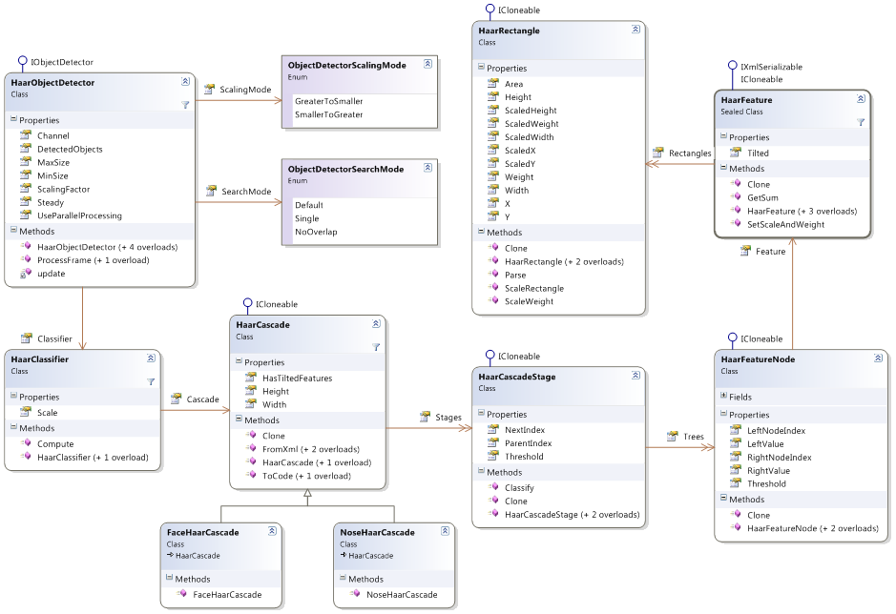
UML Diagrams/ER Diagrams/Flow Charts
Abstract
Introduction
Existing System
Proposed System
Software requirements
Architecture Model
Modules
UML Diagrams/ER Diagrams/Flow Charts
References
Class Diagram

Slide 16
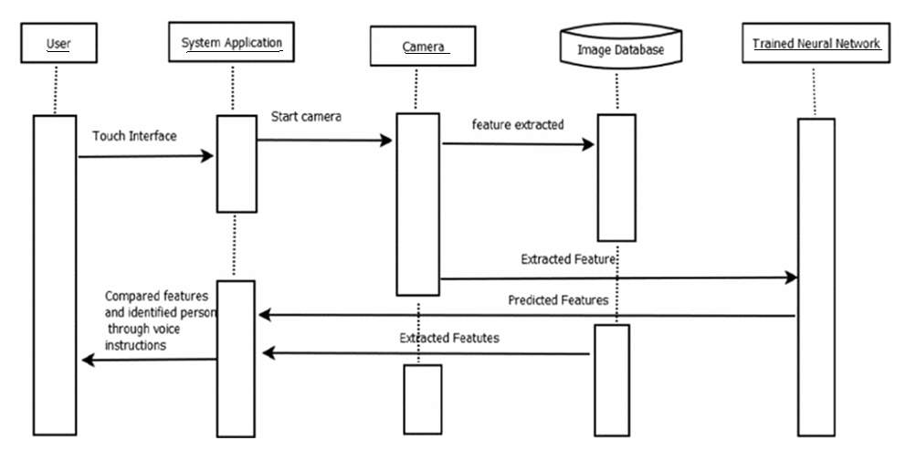
UML Diagrams/ER Diagrams/Flow Charts
Abstract
Introduction
Existing System
Proposed System
Software requirements
Architecture Model
Modules
UML Diagrams/ER Diagrams/Flow Charts
References
Sequence Diagram

Slide 17
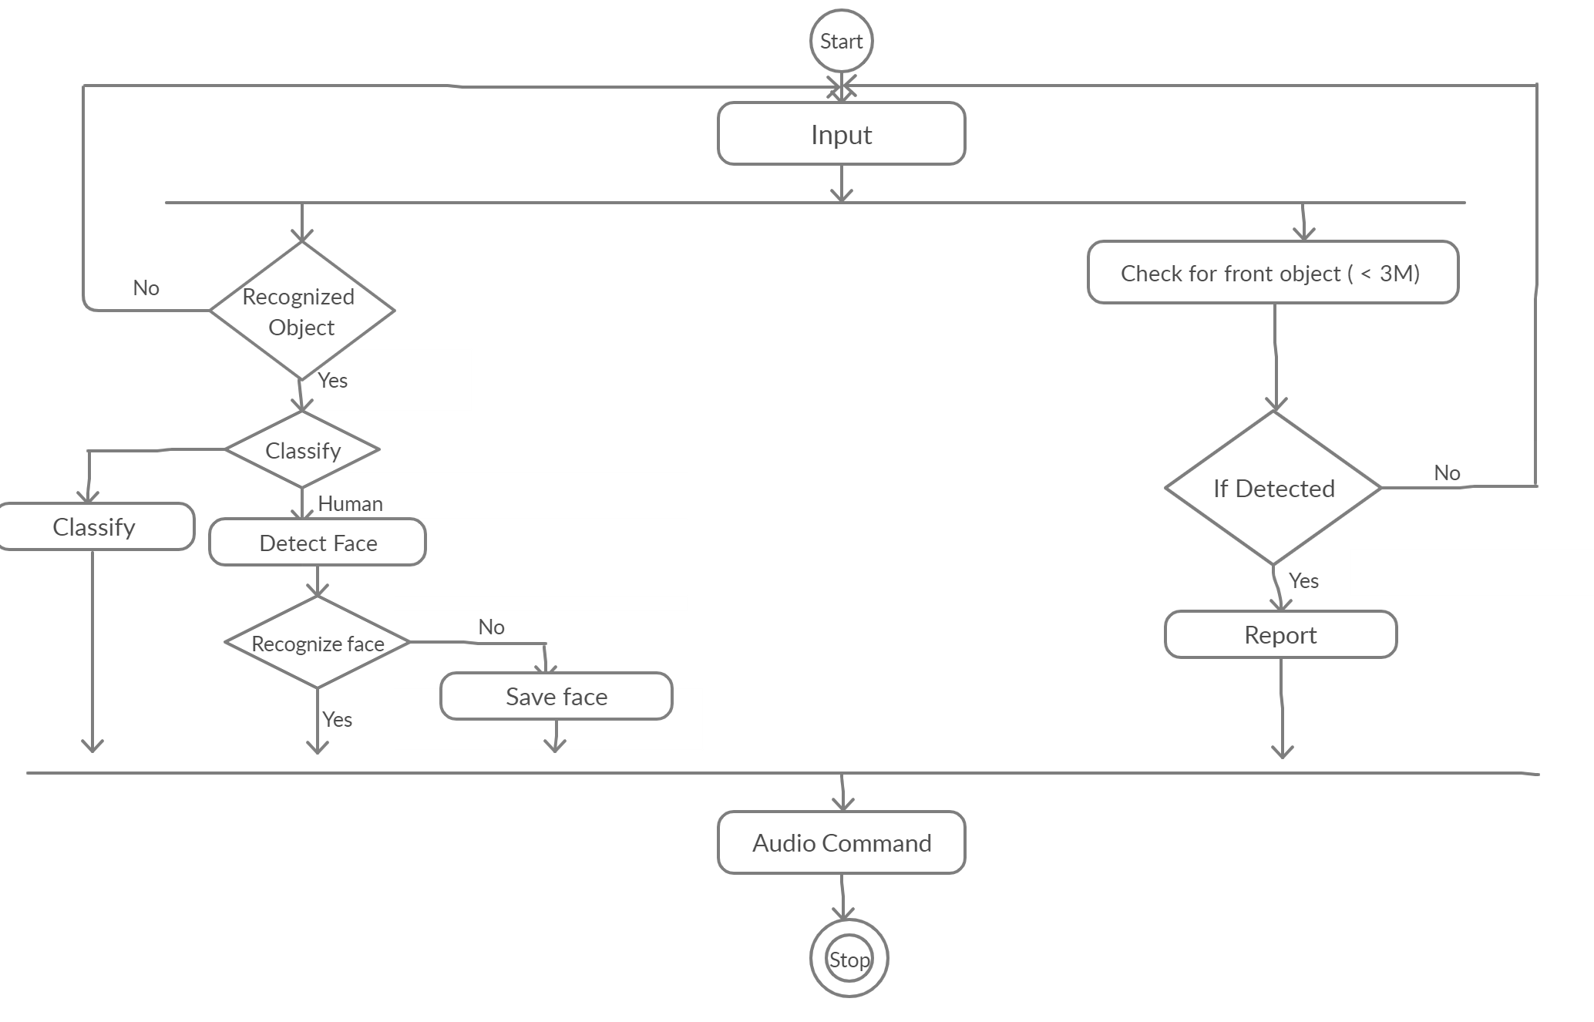
UML Diagrams/ER Diagrams/Flow Charts
Abstract
Introduction
Existing System
Proposed System
Software requirements
Architecture Model
Modules
UML Diagrams/ER Diagrams/Flow Charts
References
Activity diagram

Slide 18
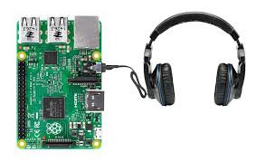


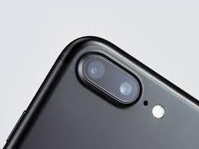


MODEL
Ip webcam
Mbl cam
Raspberry kit connected with earphones
Person getting audio
The ip web cam is used to detect the object the person wants to know and with the help of earphones the person gets the answer through voice output.

Slide 19
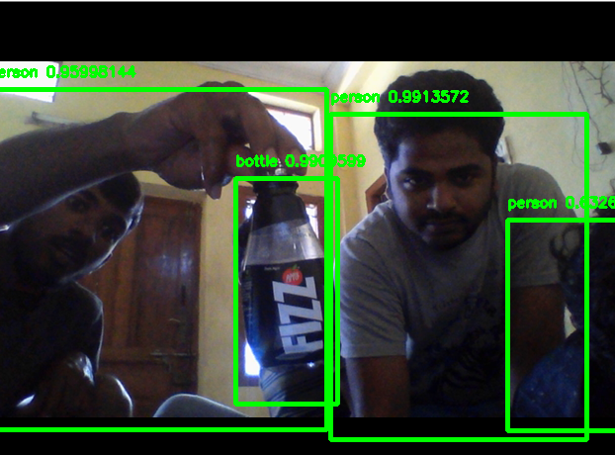
RESULTS
Object Detection

Slide 20
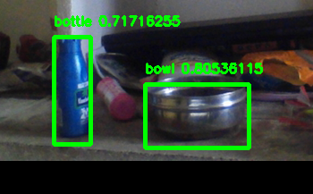
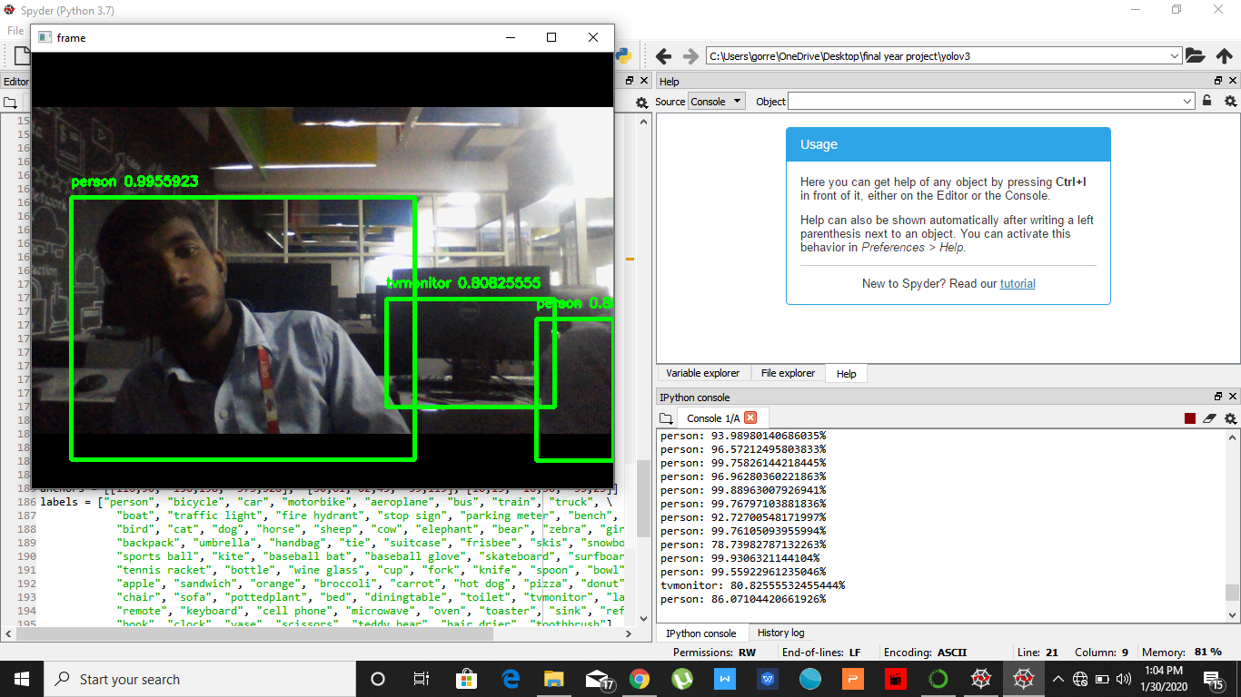
RESULTS
Object Detection

Slide 21
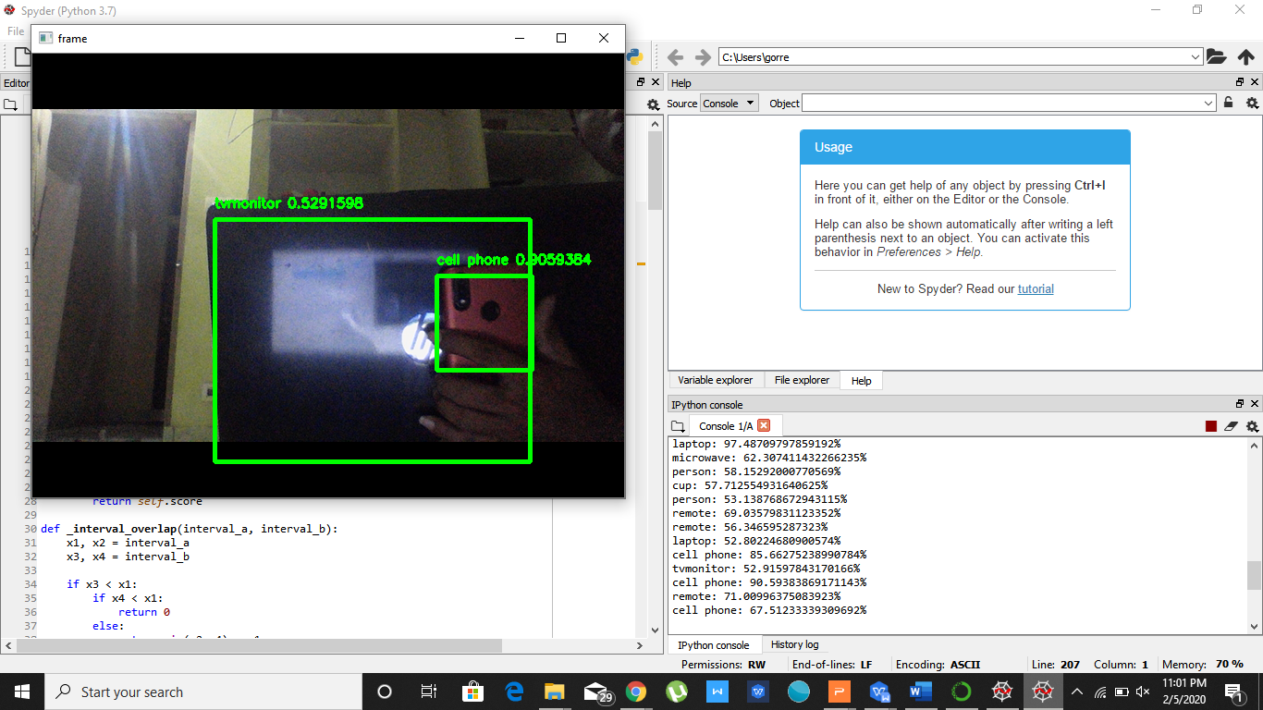
RESULTS
Object Detection

Slide 22
CONCLUSION
Due to its powerful learning ability and advantages in dealing with occlusion, scale transformation and background switches, deep learning based object detection has been a research hotspot in recent years. This paper provides a detailed review on deep learning based object detection frameworks which handle different sub-problems, such as occlusion, clutter and low resolution, with different degrees of modifications on R-CNN. The review starts on generic object detection pipelines which provide base architectures for other related tasks. Then, three other common tasks, namely salient object detection, face detection and pedestrian detection, are also briefly reviewed.

Slide 23
FUTURE SCOPE
The project is developed with objective of detecting real time objects in image, video and camera. Bounding Boxes are drawn around the detected objects along with the label indicating the class to which the object belongs. We have used CPU for the processing in the project. Future enhancements can be focused by implementing the project on the system having GPU for faster results and better accuracy.

Slide 24
Introduction
Existing System
Proposed System
Software requirements
References
Abstract
Introduction
Existing System
Proposed System
Software requirements
Architecture Model
Modules
UML Diagrams/ER Diagrams/Flow Charts
References
References
[1] Tomasz Malisiewicz and Alexei A Efros, “Improving spatial support for objects via multiple segmentations,” 2007.
[2] Thomas Blaschke, “Object based image analysis for remote sensing,” ISPRS journal of photogrammetry and remote sensing, vol. 65, no. 1, pp. 2–16, 2010.
[3] Sreenath Rao Vantaram and Eli Saber, “Survey of contemporary trends in color image segmentation,” Journal of Electronic Imaging, vol. 21, no. 4, pp. 040901–1, 2012.
[4] Liangliang Cao and Li Fei-Fei, “Spatially coherent latent topic model for concurrent segmentation and classification of objects and scenes,” in Computer Vision, 2007. ICCV 2007. IEEE 11th International Conference on. IEEE, 2007, pp. 1–8.
[5] Dorit S Hochbaum and Vikas Singh, “An efficient algorithm for co-segmentation,” in Computer Vision, 2009 IEEE 12th International Conference on. IEEE, 2009, pp. 269–276.
2/1

Slide 25
Q and A?
?

Slide 26
THANK YOU

